Slide 1

Content Management System (CMS)/Admin Training

Slide 2


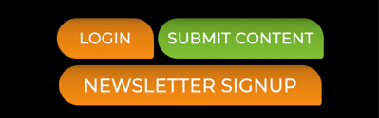
New Sponsorship
Tour of the Front End
Masthead
Editor Block
Login Buttons

Slide 3
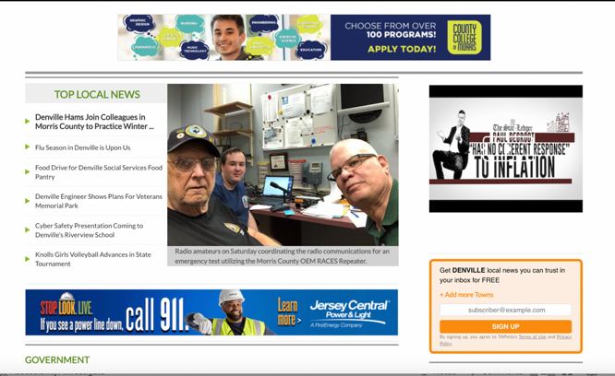
New Sponsorship
Tour of the Front End
Ads

Slide 4

New Sponsorship
Tour of the Front End
What is Templated for Each Site

Slide 5
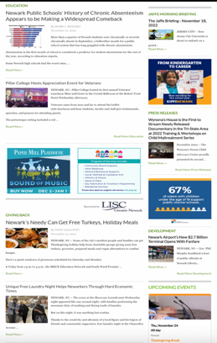
New Sponsorship
Tour of the Front End
What is Customizable for Each Site

Slide 6
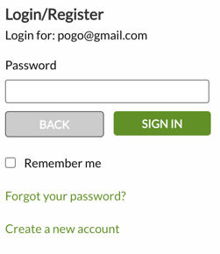
New Sponsorship
Submitting Content
To submit content, contributors/clients must log in first.
If they already have a TAPinto account, they can click login.
They would enter their email in the box under email address, and then hit next.
In the box that says password, enter the password for the account, then hit sign in.

Slide 7
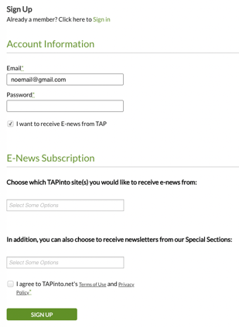
New Sponsorship
Submitting Content
If they do not yet have an account:
Click login
Enter email address
Create a password
Check off the box that says “I want to receive Enews from TAP” if they would like to subscribe

Slide 8
New Sponsorship
Submitting Content
If they do not yet have an account:
In the box under “Choose which TAPinto site(s) you would like to receive Enews from,” they would choose the towns they want to receive Enews for.
Then, click “I agree to TAPinto.net's Terms of Use and Privacy Policy*” and hit Sign Up.
They will receive an email asking for confirmation.
Once the account is confirmed, the client can begin to submit content.

Slide 9
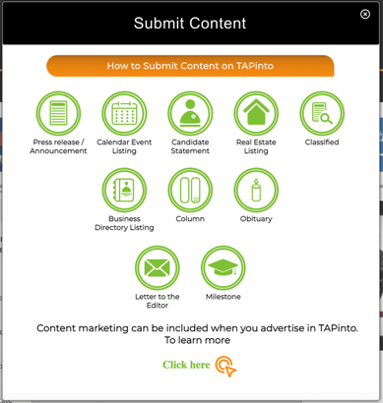
New Sponsorship
Submitting Content
To submit content, click on Submit Content.
Next, choose the content type you want to submit.
Each content item is similar, but with a few customized boxes to fill out based on the type of content you are submitting.

Slide 10
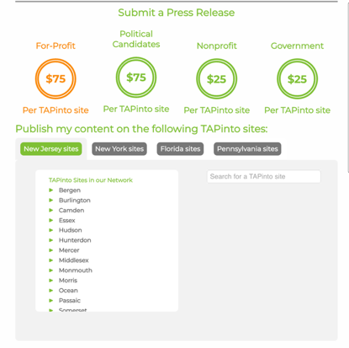
New Sponsorship
Submitting Content
Submission Screen
Select organization type
Prices Calculated
Choose Sites for Publishing

Slide 11
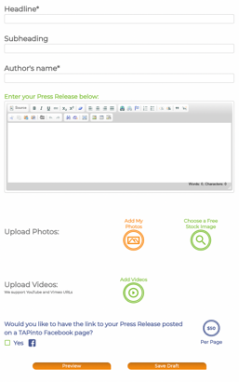
New Sponsorship
Submitting Content
Headline
Author
Article Body
Insert Images
Add Hyperlink

Slide 12
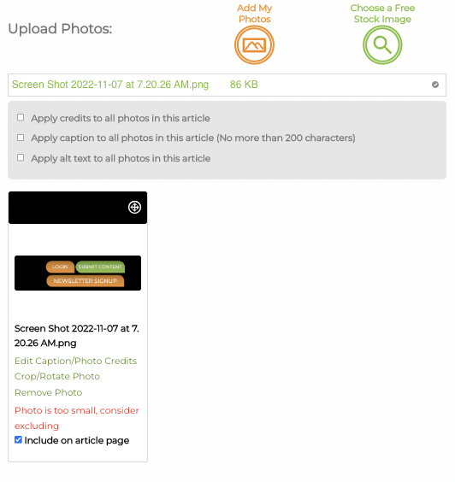
New Sponsorship
Submitting Content
Tips for photos:
Less than 20MB – GIF, JPG, PNG
3:2 aspect ratio
Bulk credit/captioning/alt text – click apply to all

Slide 13
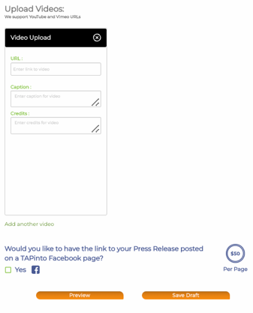
New Sponsorship
Submitting Content
Add videos
Upgrade to Facebook Post

Slide 14
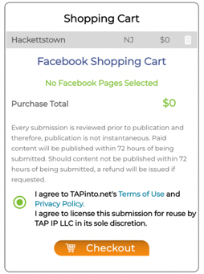
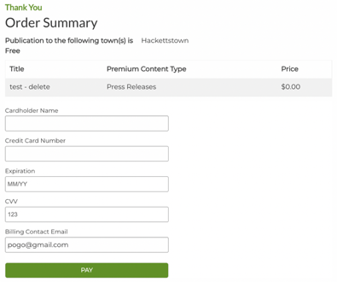
New Sponsorship
Submitting Content
Check the Terms of Use and Privacy Policy, and Licensing Agreement
Click checkout
Payment prompt
Not submitted until pay button is hit under order summary

Slide 15
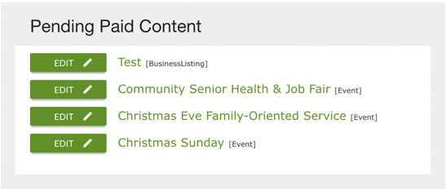
New Sponsorship
Submitting Content
When content is submitted on front end:
Will appear on back end for franchisee/editor to post
Paid content = paid item
Advertiser = free (advertiser)
Sent from account with granted exemption = free

Slide 16
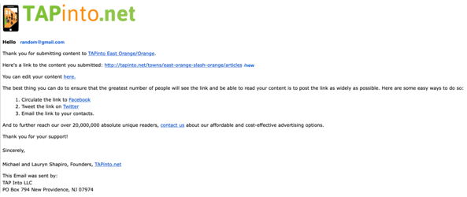
New Sponsorship
Submitting Content
Contributor can edit, clicking link in confirmation email
Content unpublished
Appear in paid pending content box
Edited by front end user
Will need to approve and publish again

Slide 17
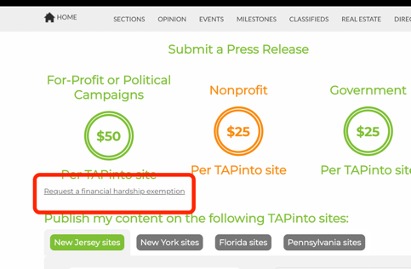
New Sponsorship
Submitting Content
Nonprofit Users can request financial hardship
Submit content, click press release
Click on nonprofit price, then request a financial hardship exemption
Add towns, give a reason
Each town will decide
Will receive email confirmation of approval/denial

Slide 18
New Sponsorship
Submitting Content
Nonprofit Users can request financial hardship
One-time exemption application
Exemption can be removed at any time
If user applies for exemption while submitting article, they will be prompted to pay

Slide 19
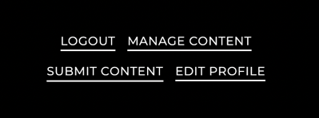
New Sponsorship
Logging in to Admin CMS
Go to TAPinto.net:
Click the Login button in the top right corner of the screen.
To access the Admin/Content Management System dashboard, go back to the top right corner.
Click manage content:
This will take you into the dashboard.
You can also log in using tapinto.net/admin.

Slide 20
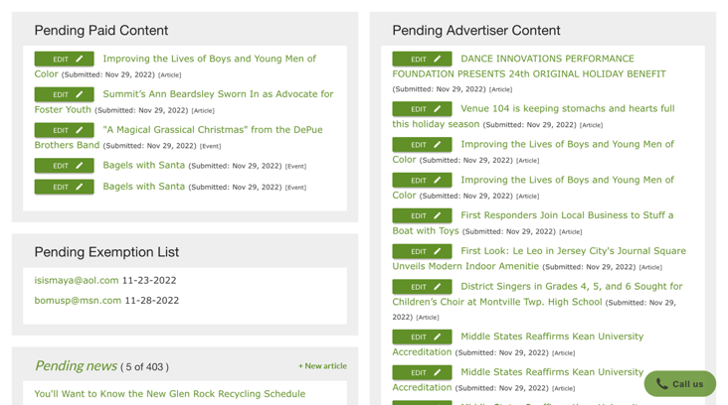
New Sponsorship
Dashboard
Your dashboard lists:
Pending articles
Events
Milestones
Real estate listings
Classifieds
Obituaries
Business directory listings

Slide 21
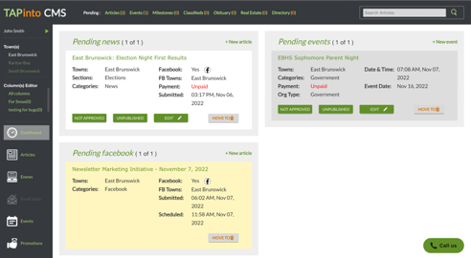
New Sponsorship
Dashboard
Files can be approved and published directly
Read submission before publishing
Access edit page
Delete file if not needed

Slide 22
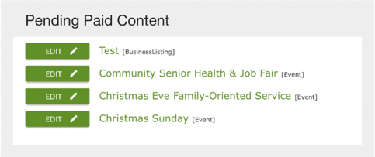
New Sponsorship
Dashboard
Paid content should be approved and published as soon as possible
Same day recommended, guaranteed within 48 hours
Facebook symbol means client paid for Facebook post too

Slide 23
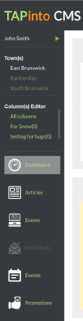
New Sponsorship
Dashboard
Tabs down the left side:
Article
Enews
Promotions

Slide 24
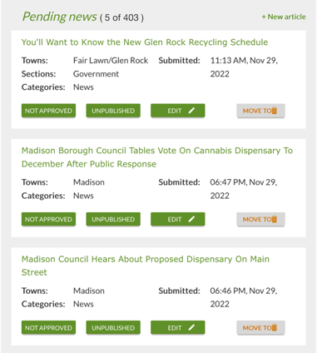
New Sponsorship
Pending Content Block
Lists all pending content
Town admin should read & spell/grammar check
Approve content
No pending content = will be blank

Slide 25
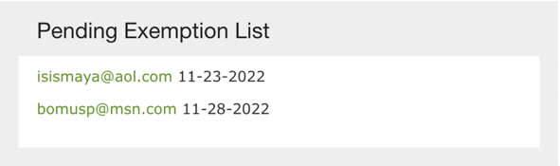
New Sponsorship
Pending Exemption List
All pending exemptions
Approve/reject – click email address
If approve, they will be able to submit content for free
Exemptions granted sparingly

Slide 26
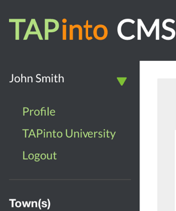
New Sponsorship
Under Username in Admin
Update user profile by clicking the arrow next to your name on the top left side of the screen

Slide 27
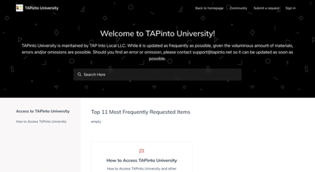
New Sponsorship
Access TAPinto University
1. Go to TAPintoUniversity.net.
2. Click the Sign In button in the top right corner of the screen.

Slide 28
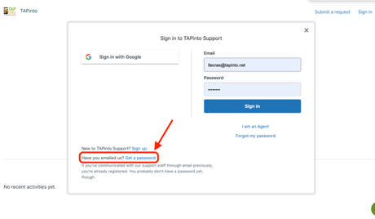
New Sponsorship
Access TAPinto University
3. In the bottom left corner of the login screen, click the "Get a Password" button.

Slide 29
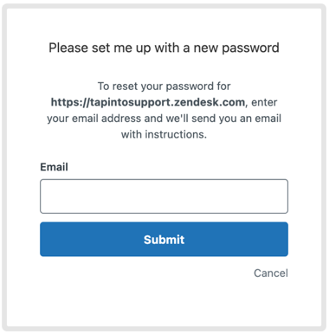
New Sponsorship
Access TAPinto University
4. Enter your TAPinto email address. An email will be sent to your @TAPinto.net email account with instructions to set your password.

Slide 30
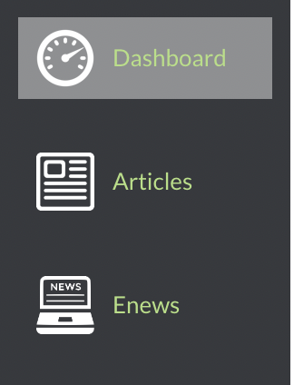
New Sponsorship
Tabs
Dashboard
Admin CMS homepage
Articles
All articles, published and unpublished
Create articles within this tab
Enews
Enews customization page

Slide 31
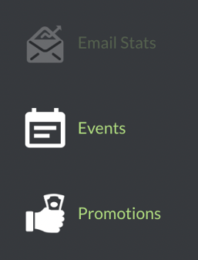
New Sponsorship
Tabs
Email Stats
Reader stats for every email you send out through Admin CMS
Events
All events, published and unpublished
Create events within this tab
Promotions
All promotions running
Create promotions within this tab

Slide 32
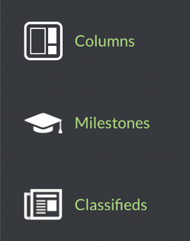
New Sponsorship
Tabs
Columns
All columns, published and unpublished
Town Admins can only see the columns listed for that town
There is no editor access if you are not the editor for the column
Milestones
All milestones, published and unpublished
Create milestones within this tab
Classifieds
All classifieds, published and unpublished.
Classifieds within this tab

Slide 33
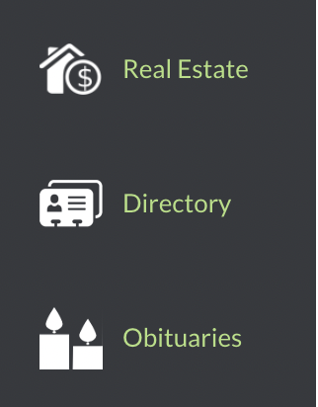
New Sponsorship
Tabs
Real Estate
All listings, published and unpublished
Create listings within this tab
Directory (Business Directory)
All directories, published and unpublished Create directory listings within this tab
Obituaries
All obituaries, published and unpublished
Create obituaries within this tab

Slide 34
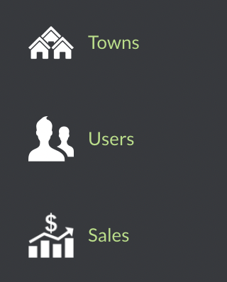
New Sponsorship
Tabs
Towns
Edit your site layout
Users
TAPinto’s user database
Edit user profiles
Sales
Current site sales

Slide 35
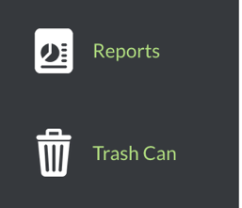
New Sponsorship
Admin
Reports
Site inventory reports for ads
View article count by town
Eblast reservation system
Trash Can
All discarded/expired articles, events, classifieds, business listings, real estate listings and milestones
Restore any content that is in the trash can
  It then appears in your dashboard for editing/publication

Slide 36
New Sponsorship
Articles
Different types of written content that is on your site or was submitted to you:
News articles
Press releases
Letters to the Editor
Candidate Statements
Guest Columns
Police Blotters

Slide 37
New Sponsorship
Articles
As a franchise owner, you can sell Sponsored Columns as part of advertising deals.
To have a column created, you must fill out the Create a Column form found on TAPinto University.
Columns are created by corporate, managed by franchisees.
You can designate the column writer as a columnist in our system through the users tab.
All columns that you manage will appear in the Columns area on the top right corner of your Dashboard.

Slide 38
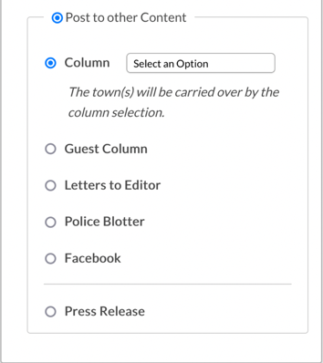
New Sponsorship
Articles
If the article is not a news story, you can instead post it as the type of content it is:
A column article
Letter to the editor
Police blotter
Press release

Slide 39
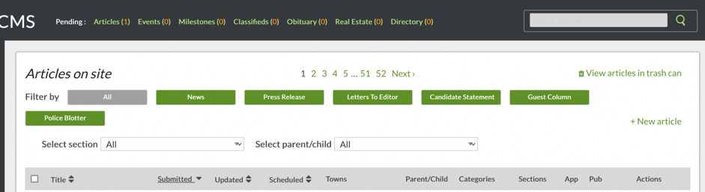
New Sponsorship
Articles
You can search for older articles through the search bar in the top right corner.
Type or paste in the article title and hit enter.

Slide 40
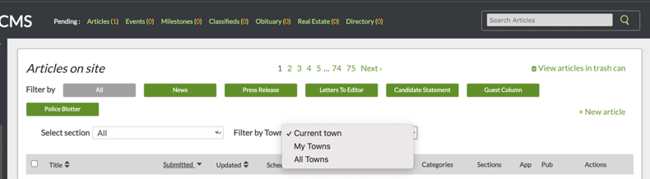
New Sponsorship
Cloning Articles
You can copy/clone stories from other sites that you would like on yours.
Click articles tab
Click articles on site
Search for article you want to clone

Slide 41
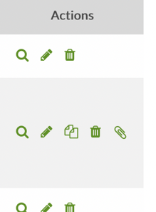
New Sponsorship
Cloning Articles
Two options
Click clone button
Click button with magnifying glass and article will be copied into your site’s article page

Slide 42
New Sponsorship
Cloning Articles
Before publishing, update the article to be specific to your town (if applicable) and post the story into the appropriate section.
When cloning, you must use the original author’s byline, unless you edit/make changes to the story.
  This includes adding pictures, changing the headline and any edits made to the body of the article.
Consult the original reporter if you have questions regarding potential changes.

Slide 43


New Sponsorship
Creating an Article
Two ways:
Articles tab, click new article
Click +New Article above articles dashboard

Slide 44
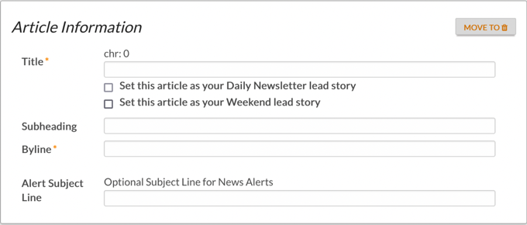
New Sponsorship
Creating an Article
Fill in all the relevant information, including headline and byline.

Slide 45

New Sponsorship
Creating an Article
For the headline, the first letter of each major word should be capitalized (but not words such as “a” “of” “and” etc.).
You can also enter a subheading for your article.

Slide 46
New Sponsorship
Creating an Article
The byline is the name of the reporter who wrote the story. If it’s a rewritten. press release you’re posting as a news story, use “TAPinto [your town] Staff”.
When posting a press release, the byline should be the name of the person who sent the release, or if you don’t have someone’s name, the name of the organization that sent it.

Slide 47
New Sponsorship
Creating an Article
If you wish to set an article as the top story in Enews, check the box under the Title section. Check off approved and published.
If you are going to send out a news alert to your subscribers, you can customize the subject line in this field.

Slide 48
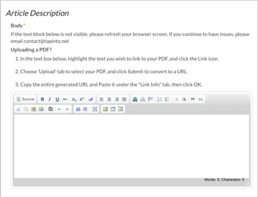
New Sponsorship
Creating an Article
The Article Description area is where you will upload the actual words.
It is highly recommended that articles be written in a word processor on your computer so that you always have a copy of the article.

Slide 49
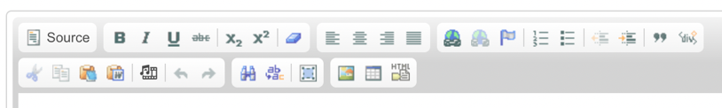
New Sponsorship
Creating an Article
The Article Description area has tools that resemble those in Microsoft Office. You can bold, underline and italicize text, custom align, hyperlink and create outlines.

Slide 50
New Sponsorship
Creating an Article
If you’re cutting and pasting from a Word document, there are also special pasting tools on the second row of tools. Click on the little Word icon and paste the text into the popup box. This will automatically format the text to our design.

Slide 51
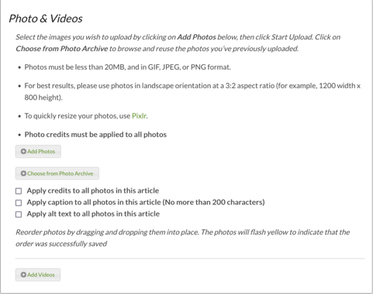
New Sponsorship
Adding Pictures and Videos
Photos & Videos section
News stories always need a photo
Click add photos to add picture
Only original photos or images that exist in our system
Don’t just pick off the internet
Photos must be under 20 MBs or they will not import.
  If you get a photo that is too large, you’ll need to resize it using Pixlr. (Link available in the Photos & Videos box, or use other photo editing software)

Slide 52
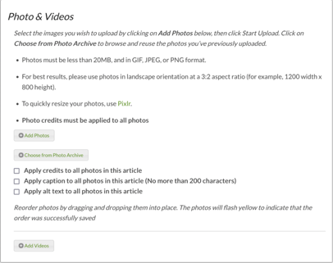
New Sponsorship
Adding Pictures and Videos
TAPinto has stock images available for stories that do not have a photo.
Click on choose from photo archive and it will take you to the photo library.
Click on stock photos or scroll through all photos to use a photo that we’ve already run.
For stock photos, you could search for photos based on the title of the image.

Slide 53
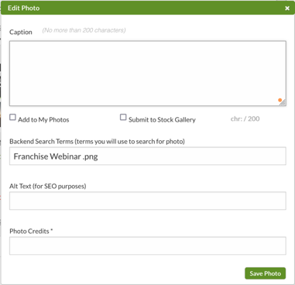
New Sponsorship
Adding Pictures and Videos
After photos are uploaded, under each thumbnail you’ll see a link for the caption and photo credit and be able to crop it. Click on those and fill them in.
Caption is the sentence(s) that describe the action and participants in the picture. You are limited to 200 characters.
Backend Search Terms is where you put searchable keywords.

Slide 54
New Sponsorship
Adding Pictures and Videos
Alt Text is alternative search text for the image. It is for SEO purposes.
Photo Credits is the name of the photographer who took the photo.
  This is required for every photo, graphic or image that is uploaded to a story.
Click save photo.

Slide 55
New Sponsorship
Using and Submitting to My Photos
From the new article area, you’ll be able to submit photos to your own gallery as well.
When you are on the editing screen of an article, scroll to the photos area and click Add Photos. Then, upload photos like you normally would.
Once the images upload, click edit captions/photo credits to create your photo gallery as well as to submit to the stock gallery.

Slide 56
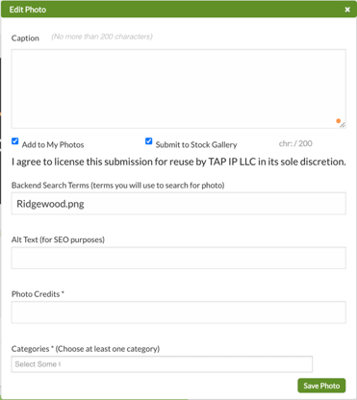
New Sponsorship
Using and Submitting to My Photos
When you suggest to the overall stock image library, messages will be sent to our corporate team to approve or reject any images. For any of my photos, those images will show in the “my photos” area.
Backend search terms are the terms you would use to search for the photos, whether it's in the stock image library or your new “my photos” section.

Slide 57
New Sponsorship
Using and Submitting to My Photos
You can also include a caption, which will carry over to my photos and the stock gallery.
Alternative text is for SEO purposes.
A photo credit is required.
Categories enables you to search by category which improves the search technology in the stock gallery and the “my photos” section.

Slide 58
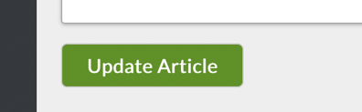
New Sponsorship
Using and Submitting to My Photos
Click save photo, and you would repeat this for all images.
When you’re ready to submit the article for publication click update article.

Slide 59
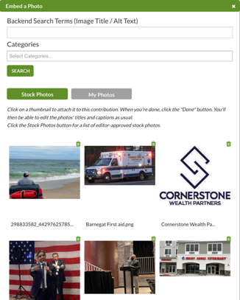
New Sponsorship
Using and Submitting to My Photos
To access your “my photos” area in any article page, whether it be a new article or an article you’re going to edit, your new my photo section will appear in the same area as the photo archive.
Click choose from the photo archive.
Then select “my photos.”

Slide 60
New Sponsorship
Using and Submitting to My Photos
You can also do a full text search or select the category.
For bulk captioning, once the photos are uploaded, if you click apply caption to all photos, you’ll be able to type in a caption.
When you approve and publish the article, you’ll be able to see the same caption for every image.

Slide 61
New Sponsorship
Adding Photos to Your Article
If you have photos that you would like to apply the same alt text to, click the box next to “apply alt text to all photos in this article” and all the images will have the same alt text.

Slide 62
New Sponsorship
Adding Photos to Your Article
If you have a story with multiple photos from the same photographer, you can apply the photo credit from one photo to all of the photos in the article. Check off the box for apply credits to all photos.

Slide 63
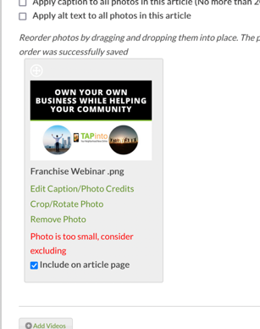
New Sponsorship
Deleting Photos from Your Article
Click remove photo underneath the thumbnail.
It takes a few minutes for the changes to take effect.

Slide 64
New Sponsorship
Rearranging Photos
Click on the pictures you want to move and drag them to where you want them.
They will briefly flash yellow to show that it worked.
YouTube and Vimeo videos can be embedded in all content on the site. Using the video button (embed media from external sites) cut and paste the video URL (not the embed URL). It will appear in the text wherever you click on the video button. You can also add the video to the photo gallery by clicking on Add Video where you see the Add Photos option.

Slide 65
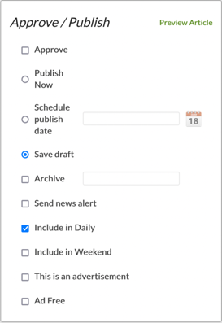
New Sponsorship
Approve and Publish Article
Select the Approve and Publish Now boxes if you want the story to appear on the site once you submit the article
If you are not ready to post, there is no need to select Approve or Publish. If the story is a draft, just include “Draft” at the start of your headline. (Don't forget to edit that out later).
If you want to schedule the article to publish later, select Approve and select the desired date and time next to schedule publish date.

Slide 66
New Sponsorship
Sending a News Alert
If the story is worth its own email to your readers, select Send News Alert so that an email will be sent to all our subscribers with the article.
This should be sent 2-3 per week, depending on the news cycle.
You can’t schedule a news alert for a future date.

Slide 67
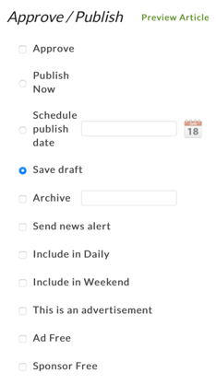
New Sponsorship
Advertiser-Related Content
For any Advertiser-related content, you must check the This is an advertisement box.
This will add a Sponsored Content tag to the article, as well as advertising language to the bottom of the content.

Slide 68
New Sponsorship
Ad-Free Content
For any content where you do not want any ads or sponsorships to appear, click the Ad free or Sponsor free box.

Slide 69
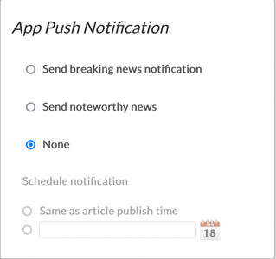
New Sponsorship
App Push Notification
If the story is worth its own app alert to your readers, select send a push notification to your APP subscribers.
Selecting send breaking news notification will send it as a breaking news alert.
If your story is newsworthy but not breaking, select send noteworthy news.
This should be used 1-4 times per day.

Slide 70
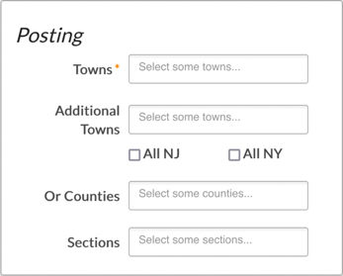
New Sponsorship
Posting Article
The Posting area is where you will decide how to post the content.
For Towns, include your town as the Main Town and other towns that you think might want the story as Additional Towns.
Please keep in mind that TAPinto is a hyperlocal publication, so unless an article has a direct impact in a town, please don’t include it.

Slide 71

New Sponsorship
Select a Section
Sections are the topics the article falls under, such as Health and Wellness, or Sports.
For each story, check off one section.

Slide 72

New Sponsorship
Top Stories on Site
If it is a good original news story, you want the story to be a town and section top story.
You can also put the story in the section you chose, and not your town’s home page.

Slide 73
New Sponsorship
Recommend to Overall Homepage
If it is a good original news story, also select Top Story for Overall Homepage so it will be considered for TAPinto’s overall homepage as well as TAPinto’s corporate social media pages.

Slide 74
New Sponsorship
Non-News Articles
If the article is not News, but is a column, letter to the editor, candidate statement or other form of content, click the Post to Other Content Button. You will be asked to select a specific secondary type of content.
If you are uploading a column article, be sure to select the column from the drop-down menu.

Slide 75

New Sponsorship
Ready to Publish
When you are done with the article, click Update Article. If you previously selected Approve and Publish, clicking Update Article will publish the article on your site. Otherwise, the article will remain as a draft, and will appear in your dashboard and article database so you can access later.
If you need to make changes to this article, click the Edit or pencil button in the dashboard or article database. Edits could take several minutes to show up.

Slide 76

New Sponsorship
Article Notification System
Each night, the registered content editor for each site will receive an email from the CMS detailing the stories that are unapproved and unpublished in your admin.

Slide 77
New Sponsorship
Customize Newsletter/Breaking News Articles
You can customize the Daily/Weekly Newsletter top story.
The alert subject is used to customize breaking news articles.
You can also click the top story option under the headline to make the article a top story in your Enews.
If multiple top stories are selected, the system will put both at the top, with the newest story being the “Featured” story. This process works the same for the Weekend newsletter.

Slide 78

New Sponsorship
Promotional Footers & Editor’s Notes
Town admins can add Promotional Footers and Editor’s Notes to the bottom of all articles created in the CMS.
The Promotional Footer should be utilized to promote various aspects of your business, including social media channels, Enews sign-ups, APP downloads and marketing opportunities.

Slide 79

New Sponsorship
Promotional Footers & Editor’s Notes
The Editor’s Note functionality will create consistent formatting for editor’s notes across the network.
Like Promotional footers, each franchise will have the ability to create single-use and templated editor’s notes. Editor’s Notes are for purposes of transparency with the reader - for example, if the franchisee or reporter has a business or personal relationship with the subject of the story, it should be disclosed to the reader through an Editor’s Note.

Slide 80

New Sponsorship
Editing an Old Article
To edit a previously written article:
Click the articles tab & searching for the article in the search bar in the top right corner
Click the green pen icon on the left side of the screen that is in line with the article

Slide 81

New Sponsorship
Enews
Click on the Enews tab on the left side of the dashboard to:
Customize subject line of Enews
Preview next day’s Enews
Check stats
Both daily and weekly can be customized

Slide 82

New Sponsorship
Enews
Enews subject line is important.
Ideal subject line:
Focuses on the BIG story of the day
Creates an interest in the stories below the lead/featured story

Slide 83
New Sponsorship
How to Customize the Enews Subject Line
Our technology allows you to customize the subject line of your Enews daily.
Click the Enews button on the left side of your admin dashboard located directly under the Articles tab.
The first line on the page will tell you what the top story of the next day’s email is currently set at.

Slide 84

New Sponsorship
How to Customize the Enews Subject Line
The second line on the Enews page will tell you what the current subject line is. It will always default to the headline of the lead story.
To change the subject line, which we highly recommend:
Click the green edit button.
Doing so triggers a pop-up box to appear on your screen.
Type in your desired subject line and click update.

Slide 85
New Sponsorship
How to Customize the Enews Subject Line
If you choose not to customize the subject line, it will default to the headline of the top article for that day's Enews.
We suggest previewing 2 to 3 articles.
Grants for the Arts | Blue Devil Bowling: TAPinto Westfield

Slide 86

New Sponsorship
Events – Daily and Weekly
To customize the events in the daily or weekend Enews:
Click Choose your Newsletter Events.
Select events from dropdown and hit save.
If you don’t customize events, the system selects the next four events in the calendar.

Slide 87

New Sponsorship
Previewing Daily and Weekend Enews
Once your changes are made, your new subject line will show on the Enews page.
To preview Enews:
Type your email address into the field and click Preview.
A copy of the next day’s Enews (or upcoming Weekend Enews) will be sent to your email.

Slide 88

New Sponsorship
Enews Customization
Daily – you can customize:
Articles, Columns, Events, Press Releases, Police Blotter, Candidate Statements, Letters to the Editor, Milestones, Obituaries, Real Estate Listings, Classifieds, and Directories
Weekly – you can customize:
Articles, Columns, Events, and Real Estate Listings

Slide 89

New Sponsorship
Enews Customization
To customize a section:
Go to choose your section name box
Select yes where it reads custom section name on newsletter

Slide 90

New Sponsorship
Enews Customization
Click on dropdown box
  All the section’s articles that you marked for Enews will appear
Choose the articles you want in Enews and hit save

Slide 91

New Sponsorship
Enews Customization
The selected articles will appear to the left in the section name block
Drag and drop to rearrange in the order you’d like
A yellow flash confirms changes were saved

Slide 92

New Sponsorship
Enews Customization
You can remove articles you chose, setting articles back to default by selecting no
Hit save
Upcoming top articles will come back in chronological order by the most recent date

Slide 93

New Sponsorship
Email Stats
To access Enews, Weekend newsletter, E-Blast, Breaking News and Subscriber stats:
Hover over the Email Stats tab, then click the corresponding item from the dropdown menu.
Full stats for the daily Enews are available 24 hours after the email has been sent.

Slide 94




New Sponsorship
Stats
To check E-blast, News Alert, Daily Enews and/or Weekly Enews stats:
On Admin CMS, hover over the E-blast, News Alert, Daily Enews or Weekly Enews tab (to correspond with the report stats you want to receive).
Choose Promotions from the dropdown.
Each promotion file will be listed with Email Subject, Town / List, Date, Emails Sent, Open Count, Click Count, Unsubscribed, Open Rate, and Click Rate.

Slide 95

New Sponsorship
Checking Your E-mail Subscriber Count
To check your subscriber counts, repeat the following steps:
On Admin CMS, hover over the "Email Stats" tab.
Choose Subscribers from the dropdown.
The subscribers will be listed with Town, Daily, Weekly, News Alerts, Promotions and Events.

Slide 96


New Sponsorship
Events
To create a new event, hover over the specific tab and click New Event or click the tab and press +New Event in the top right corner of the screen.
All fields with the red asterisk are required before you can complete the form.

Slide 97

New Sponsorship
Events
1. In the Notes box, insert any notes for the event for future reference or if you are sharing the event with any other towns and would like them to know anything about the event.

Slide 98

New Sponsorship
Events
2. In the Event Information box, insert the Event name, date and time, as well as the location, and phone number.

Slide 99

New Sponsorship
Events
3. In the Contact Information box, insert the contact person's name and phone number.
That information will only be seen by you.
You can also list the contact person’s information below that.
The information added in the bottom six lines will be visible in the public event listing.

Slide 100

New Sponsorship
Events
4. In the Event Description box, paste a description of the property given to you by the client.

Slide 101

New Sponsorship
Events
5. In the Photos box, insert any photos and videos of the event.

Slide 102

New Sponsorship
Events
6. In the Event Type box, select:
For profit – businesses, organizations and events who want to submit an event.
Nonprofit is for nonprofit organizations.
Governmental is for any governmental event.

Slide 103
New Sponsorship
Events
6. In the Event Type box, select:
Paid event for any paid event. We guarantee publication within 48 hours.
Unpaid is an unpaid event(s) not paid for and is up to the franchisee to publish.
A free event is for advertiser- submitted events or events submitted by people with exemptions.

Slide 104

New Sponsorship
Events
7. In the Approve/Publish box, make sure to check off approved and published if you're ready for the listing to go live.
You can mark to include it in the Enews as well.

Slide 105

New Sponsorship
Events
8. In the Posting box, insert your town.

Slide 106

New Sponsorship
Events
9. In the Facebook box, if this is a part of the package for the listing, insert your town, a small excerpt/description of the listing, the Facebook URL to the listing or the agents page, and choose when you want it to publish to Facebook.

Slide 107

New Sponsorship
Events
10. Click New Event when you are finished.

Slide 108
New Sponsorship
Burbio
TAPinto has partnered with Burbio, an events calendar aggregator, to provide local government and school calendar events to our town site dashboards.
Each town site where the town government and school district has a digital calendar will receive event listings to their dashboards for approval. Each Burbio listing can be edited by the town editors or franchisees.

Slide 109
New Sponsorship
Burbio
Possible events include:
Town council meetings
Planning board meetings
Key town events
Board of education meetings
Key school events

Slide 110
New Sponsorship
Burbio
This partnership is at no cost to our franchisees.
If you wish to not receive these event listings, please email Support@tapinto.net.
It is all or nothing, so if you only want to receive the town or schools (and not both), we recommend just deleting the events you don't want.

Slide 111
New Sponsorship
Milestones
Milestones are created using the Submit Content area on the front/user side of the site or through the backend admin portal.
Town Admins can edit and approve/publish Milestones from the CMS portal.

Slide 112

New Sponsorship
Milestones
On your admin CMS dashboard, you will see pending milestones. Click on the title of the milestone.

Slide 113

New Sponsorship
Milestones
2. Once you see this page, click Edit.

Slide 114

New Sponsorship
Milestones
3. In the Milestone Information box, you can see the title of the milestone. If you would like to change or edit it, you can.

Slide 115

New Sponsorship
Milestones
4. In the Contact Information box, you will see the contact person's name, phone number, and email address. That information can only be seen by you. You can adjust if needed.

Slide 116

New Sponsorship
Milestones
5. In the Milestone Description box, there should be a description of the milestone from the client. Proofread and adjust if needed.

Slide 117

New Sponsorship
Milestones
6. In Photos and Videos, there may be images for the milestone. You can adjust if needed.

Slide 118

New Sponsorship
Milestones
7. In the Approve/Publish box, make sure to check off approved and published if you're ready for the listing to go live. You can mark to include it in the Enews as well.

Slide 119

New Sponsorship
Milestones
8. In the Posting box, insert your town.

Slide 120

New Sponsorship
Milestones
9. Click Update milestone when you are finished.

Slide 121


New Sponsorship
Real Estate Listings
Real Estate Listings appear in the Real Estate area on your site. Users can submit real estate listings and publication is guaranteed within 48 hours.
To create a new real estate listing, hover over the specific tab and click New Real Estate or click the tab and press +New Real Estate Listing in the top right corner of the screen.

Slide 122

New Sponsorship
Real Estate Listings
In the Listing Information box, insert the title of the listing as well as a byline.

Slide 123

New Sponsorship
Real Estate Listings
2. In the Property Information box, insert the address, city, state, and zip code. You can also list the bathrooms, bedrooms, lot size, price, and the direct URL to the listing as well.

Slide 124

New Sponsorship
Real Estate Listings
3. In the Realtor Information box, insert the realtor's name, phone number, email address, link to their website if they have one, the name of their agency, and the agencies phone number.

Slide 125

New Sponsorship
Real Estate Listings
4. In the Listing Description box, paste a description of the property given to you by the realtor.

Slide 126

New Sponsorship
Real Estate Listings
5. In Photos and Videos, insert any photos and videos of the property.

Slide 127

New Sponsorship
Real Estate Listings
6. In the Posting box, insert your town.

Slide 128
New Sponsorship
Real Estate Listings
7. In the Approve/Publish box, make sure to check off approved and published if you're ready for the listing to go live. You can mark to include it in the Enews as well.

Slide 129

New Sponsorship
Real Estate Listings
8. In the Facebook box, if this is a part of the package for the listing, insert your town, a small excerpt/description of the listing, the Facebook URL to the listing or the agents page, and choose when you want it to publish to Facebook.

Slide 130

New Sponsorship
Real Estate Listings
9. Click Create Listing when you are finished.

Slide 131

New Sponsorship
Real Estate Listings
10. If you want to Edit the listing, such as adding to it or to unpublish it when it has been sold, navigate to the listing in Admin CMS and click Edit.

Slide 132


New Sponsorship
Business Directory
Directories are business listings that appear in the Directories area on your site. Users can submit directories, and publication is guaranteed within 48 hours.
To create a new business listing, hover over the specific tab and click New Directory or click the tab and press +New Directory in the top right corner of the screen.

Slide 133

New Sponsorship
Business Directory
In the Directory Information box, insert the name of the business as well as a logo.

Slide 134

New Sponsorship
Business Directory
2. In the Business Information box, insert the address, phone number and other information.

Slide 135

New Sponsorship
Business Directory
3. In the Contact Information box, insert the contact person's name and phone number. This will only be seen by you.

Slide 136

New Sponsorship
Business Directory
4. In the Directory Description box, paste a description of the business given to you by the client.

Slide 137

New Sponsorship
Business Directory
5. In Photos and Videos, insert any photos and videos for the business. The recommended size for a business listing image is 300x60. Anything bigger will be proportionally re-sized to fit.

Slide 138

New Sponsorship
Business Directory
6. In the Directory Type box, check off for profit or non profit.

Slide 139

New Sponsorship
Business Directory
7. In the Approve/Publish box, make sure to check off approved and published if you're ready for the business listing to go live. You can mark to include it in the Enews as well.

Slide 140

New Sponsorship
Business Directory
8. In the Posting box, insert your town.

Slide 141

New Sponsorship
Business Directory
9. In the Facebook box, if this is a part of the package for the listing, insert your town, a small excerpt/description of the business, the Facebook URL to the business page, and choose when you want it to publish to Facebook.

Slide 142

New Sponsorship
Business Directory
10. Click Create Listing when you are finished.

Slide 143


New Sponsorship
Obituaries
You can post obituaries from any funeral home in your area (or beyond). We recommend you partner with your local funeral homes to set up an account for them to pay for and post obituaries directly to the site.
We do not accept obituaries from individuals, only funeral homes.
To create a new obituary, hover over the specific tab and click New Obituary or click the tab and press +New Obituary in the top right corner of the screen.

Slide 144

New Sponsorship
Obituaries
In the Obituary Information box, insert the name of the deceased, their date of birth, and their date of death.

Slide 145

New Sponsorship
Obituaries
2. In the Services Information box, choose the funeral home name.
For visitation, service, burial, and/or cremation, put the date and time of each one, and the name and address.

Slide 146

New Sponsorship
Obituaries
3. In the Listing Description box, paste a description of the deceased given to you by the family or funeral home.

Slide 147

New Sponsorship
Obituaries
4. In Photos and Videos, insert any photos and videos of the deceased.

Slide 148

New Sponsorship
Obituaries
5. In the Approve/Publish box, make sure to check off approved and published if you're ready for the obituary to go live. You can mark to include it in the Enews as well.

Slide 149

New Sponsorship
Obituaries
6. In the Posting box, insert your town.

Slide 150

New Sponsorship
Obituaries
7. Click Create Obituary when you are finished.

Slide 151
New Sponsorship
Towns
The Towns tab is where you will go to create the custom look and feel for your site.
This is where you can move sections around, add new sections and columns (after they’ve been created by corporate) and add/remove advertising blocks as needed.
Note: Contact Darlene Cullen (dcullen@tapinto.net) prior to customizing your site.

Slide 152

New Sponsorship
How to Customize Your Nav Bar
Go to Admin CMS
Click on towns tab
Click on the name of your town, shown in green
Click edit menu

Slide 153

New Sponsorship
How to Customize Your Nav Bar
Click add menu item
Chose item
Repeat if necessary to add multiple items

Slide 154

New Sponsorship
How to Customize Your Nav Bar
Once items are chosen, you can add drop-down list to menu items
Click add secondary menu item
Choose secondary menu item by clicking blank box
Continue until you’ve added everything from the dropdown list

Slide 155

New Sponsorship
How to Customize Your Nav Bar
Click save menu
Green box with confirmation will appear
Exit out of page

Slide 156

New Sponsorship
How to Customize Your Nav Bar
To delete menu item
Click the orange trash can and click save menu

Slide 157


New Sponsorship
Accessing Blocks on Your Site
To access the ad, column, section blocks on your site, follow these steps:
Step 1 - Go into your Dashboard
Step 2 - Click the Towns tab on the left side of the page
Step 3 - Select your town
Step 4 - Click the Edit button

Slide 158

New Sponsorship
Creating a Block
To create a block, use the dropdown menu to choose what kind of block you want to create.
Use the dropdown menu directly to the right of it to create the block in either the left or right column on the page.

Slide 159


New Sponsorship
Create a Block
You can add the following block types:
Business Listing Block
Show your business listings on a page
Category Block
Add an overall Candidate Statement, Guest Column, Letter to the Editor, News, Police Blotter or Press Release

Slide 160


New Sponsorship
Create a Block
Column Block
Add a specific column to your site
Events Block
Add a Calendar Events area

Slide 161


New Sponsorship
Create a Block
Obituaries Block
For obituaries
Facebook Block
Add your Facebook posts

Slide 162


New Sponsorship
Create a Block
Featured Columnist
Promote a featured columnist
Real Estate Block
Promote Real Estate Listings

Slide 163


New Sponsorship
Create a Block
Section Block
Add a section to your homepage
Twitter Block
Add your Twitter feed

Slide 164


New Sponsorship
Create a Block
Ad Block
Add an ad spot to your site
Milestones Block
Add milestones to your main page

Slide 165

New Sponsorship
Moving Blocks
Click and drag the block to your desired location.
You will see a yellow flash on the screen to indicate that the change was saved.
Scroll down the page to get to the blocks.

Slide 166
New Sponsorship
Moving Blocks
To add a block/section:
Click the type of block you would like to add where it reads “Insert a …” under Blocks. If you want to add a unique section, select Title Block otherwise select one of the pre-determined options.
Before you add a Section, make sure to check with support to ensure the same section was not created for another town.
If that is the case, support will add the section to your town.

Slide 167

New Sponsorship
Moving Blocks
To delete a block/section:
Click the Remove button at the bottom of the colored block.
Please note, for any change to take effect, you must click the green Update Town button above the overall Block section.

Slide 168
New Sponsorship
How to Decide When to Remove a Section/Block
While unique section blocks are beneficial in most cases, if you are not consistently filling these blocks with content or ads, there could be a negative effect on the operating speed of your site.
If you have blocks set up with nothing chosen from the block’s dropdown menu(s) or have a published block that you are no longer utilizing, we recommend that you remove these blocks.
It will not erase past articles written for that column, category or section and you are still able to add that column/category/section block back on your site at any time in the future.

Slide 169
New Sponsorship
Users
All franchisees can create, edit and unsubscribe user accounts.
Users accounts are created for readers to receive the daily e-newsletter and e-blasts.
These accounts are also created for columnists, advertisers and contributors to submit content to the site.

Slide 170

New Sponsorship
Creating a New User Account
There are two ways to create a new user account:
1. Hover over the User tab on the left side of the CMS/Admin Portal and click New User.

Slide 171

New Sponsorship
Creating a New User Account
2. Click the User tab on the left side of the CMS/Admin Portal. Once you see the user database on your screen, click the green + New User button on the top right corner of the screen.

Slide 172

New Sponsorship
Creating a New User Account
Once you are on the New User screen, follow these steps to set up the account:
Fill out the two required fields: Email and Towns. This should be the town the person would like to receive the newsletter and e-blasts from.

Slide 173

New Sponsorship
Creating a New User Account
2. Check off the first four boxes under Delivery Frequency

Slide 174

New Sponsorship
Creating a New User Account
3. Scroll down to the roles and select Subscriber from the dropdown menu.

Slide 175

New Sponsorship
Creating a New User Account
4. If the user account is also for a content contributor (columnist, advertiser, etc.), you should click the green “Add new Role” link and select the appropriate secondary role from the dropdown menu.
Subscriber should always be the first role

Slide 176
New Sponsorship
Creating a New User Account
For Advertisers, you must also select the ad file that the user account should be attached to. This will allow advertisers to submit content to the site for the towns in which they are advertising.
For Columnists, you must also select the column the user account should be attached to. This will allow columnists to submit column articles to the specific column.

Slide 177

New Sponsorship
Creating a New User Account
5. Scroll to the bottom of the page and click Create User.

Slide 178
New Sponsorship
Creating a New User Account
6. User accounts should be created for all advertisers that have content marketing included in their advertising package, as well as any columnists who have their own column. If the advertiser or columnist doesn’t already have an account, you should create one for them.

Slide 179
New Sponsorship
Editing a User Account
As a Town Admin, you have the authority to edit a user account.
User requests to unsubscribe from the daily newsletter or E-blasts.
You might also want to add a user as a contributor or advertiser.

Slide 180

New Sponsorship
Editing a User Account
To edit a User Account, follow these steps:
Click the Users tab on the left side of the CMS/Admin Portal.

Slide 181
New Sponsorship
Editing a User Account
2. Search for the user’s account using their email and the search bar on the top right corner of the page.

Slide 182

New Sponsorship
Editing a User Account
3. Once the user account appears, click the Pencil icon on the right side of the page to edit the account.

Slide 183
New Sponsorship
Editing a User Account
To remove the user from the email list:
Check the box next to unsubscribed (only box checked).

Slide 184
New Sponsorship
Editing a User Account
If you need to add a new role to the account, scroll down to the Roles area and click the green Add new Role link. Follow the prompts to complete the Role addition.

Slide 185
New Sponsorship
Editing a User Account
To delete a user’s role, simply scroll down to the Roles area and click the X next to the role you wish to delete.
Note: For user accounts associated with ads, the user will automatically lose posting rights when the ad file expires.

Slide 186

New Sponsorship
Deleting a User Account
To delete a user’s account:
Search for the user account using the users’ email address. Click the trash can icon on the right side of the screen next to the account you wish to delete.

Slide 187

New Sponsorship
Deleting a User Account
If you don’t see a trash can icon, edit the User account and remove the towns and delivery options described previously.

Slide 188
New Sponsorship
Reports
TAPinto has created an inventory and reservation report in the CMS/admin.
You can now see what ads, sponsorships, eblasts and other marketing options have been sold on other sites as well as what exclusive inventory has been reserved.
You are also able to see available inventory to make it easier to cross-sell marketing into other TAPinto sites. You can also search by business category - for example, if you want to see what realtors are advertising on what TAPinto sites.

Slide 189

New Sponsorship
Reports
Hover over the Reports tab in admin CMS.
Click the Inventory Reports.

Slide 190

New Sponsorship
Reports
3. Select from the dropdown menus as you desire.
4. Once all the information is filled out, click Generate Report.

Slide 191

New Sponsorship
Block a Town and Date in the Reservations System
To block a town and date in the Reservations system for Eblasts, Sponsors, Video ads, Enews ads:
Create a new Social Media/Ala Carte File in the Promotions tab, by clicking Social Media/Ala Carte and then +New Social Media on the right side.

Slide 192

New Sponsorship
Block a Town and Date in the Reservations System
2. Pick the company name from the drop down.
If the company name is not in the drop down, create a new company by clicking on New Company.

Slide 193
New Sponsorship
Block a Town and Date in the Reservations System
3. The ad name should always be the company name plus the product.
You must use the company name followed by the description of the product especially when reserving a sponsorship.
An example would be Edison HVAC Sponsor Business and Finance, Edison HVAC as the company name, Sponsor to indicate it is a sponsor file, and Business and Finance to describe the product.

Slide 194

New Sponsorship
Block a Town and Date in the Reservations System
4. Check off the Reservation Box and the following selections will appear:
  Reservation Type
  Start and end date

Slide 195


New Sponsorship
Block a Town and Date in the Reservations System
5. After picking the Reservation type, pick from the drop down the product you are reserving and enter the reservation start and end date.

Slide 196

New Sponsorship
Block a Town and Date in the Reservations System
6. Go to the Sales Information box in the top right corner and fill in the email address of the selling franchisee, the selling town, and any additional towns you want to reserve for this date.
You do not need to fill in anything else in the Sales information block.

Slide 197

New Sponsorship
Block a Town and Date in the Reservations System
7. Go to the bottom of the screen and hit save.

Slide 198
New Sponsorship
Block a Town and Date in the Reservations System
8. If you would like to verify the reservation, go to Reports, and click on Inventory Reports in the dropdown.

Slide 199

New Sponsorship
Block a Town and Date in the Reservations System
9. Pick the product type, then select your town or leave at all towns, put in the start, and end date, check the box next to Include reservations and then click generate report.

Slide 200

New Sponsorship
Block a Town and Date in the Reservations System
10. You will see the reservation for your product.

Slide 201

New Sponsorship
Trash Can
All deleted or expired articles, classifieds, business listings, real estate listings and milestones are held in the trash can for 30 days.
You can restore or permanently delete an item in the trash can tab.
1. To find content in the trash can, hover over the trash can icon and click the tab you want.

Slide 202

New Sponsorship
Trash Can
2. Then type in the content name in the search box in the top right corner of the screen and hit enter.

Slide 203

New Sponsorship
Trash Can
3. Once the content comes up, click the Restore button on the right side of the screen, or the delete button.
You can find restored items in their corresponding tabs in admin CMS.
Events, once deleted or expired, are gone permanently.

Slide 204
CMS/Admin Training
If you have questions, reach out to support@tapinto.net

